Slide 1
Capstone Engagement
Assessment, Analysis, and Hardening of a Vulnerable System

Slide 2
Table of Contents
This document contains the following sections:
01
Network Topology
02
Red Team: Security Assessment
03
Blue Team: Log Analysis and Attack Characterization
Hardening: Proposed Alarms and Mitigation Strategies
04

Slide 3
Network Topology
3

Slide 4
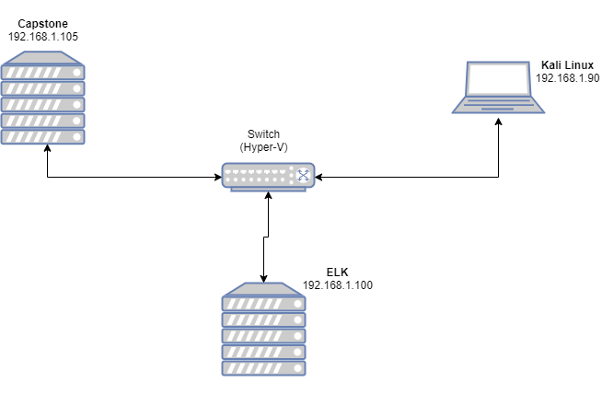
Network Topology
Network
Address Range: 192.168.1.0/24
Netmask:
Gateway:
Machines
IPv4:
OS: Linux
Hostname: server1
IPv4:
OS:
Hostname:
IPv4:
OS:
Hostname:
IPv4:
OS:
Hostname:

Slide 5

Red Team
Security Assessment
5

Slide 6
Recon: Describing the Target
Nmap identified the following hosts on the network:
Hostname | IP Address | R.ole on Network
server1 (Captsone) | 192.168.1.105 | Web server (our target)
ELK | 192.168.1.100 | Receives filebeat, metricbeat, and packetbeat data from server1 for Blue team analysis.
Kali | 192.168.1.90 | Attack machine (our machine)
 | 192.168.1.1 | Gateway

Slide 7
Vulnerability Assessment
The assessment uncovered the following critical vulnerabilities in the target:
Vulnerability | Description | Impact
CWE-200: Exposure of Sensitive Information to an Unauthorized Actor (I) | Information is disclosed that the recipient is not meant to receive. | Learned of secret_folder directory.
OWASP A01:2021 Broken Access Control | Access controls that should keep us out don’t work. | Brute forced password to access secret_folder directory.
CWE-200: Exposure of Sensitive Information to an Unauthorized Actor (II) | Information is disclosed that the recipient is not meant to receive. | Found credentials for accessing webdav share.
OWASP A02:2021 – Cryptographic Failures | Deprecated hash functions (e.g. MD5 or SHA1) are in use. | Able to crack (i.e. reverse) password hash and get plaintext credentials.
CWE-434: Unrestricted Upload of File with Dangerous Type | Arbitrary code execution is possible if the uploaded file is interpreted and executed as code. | Uploaded php reverse shell to webdav share. Executed to obtain reverse shell.
OWASP A05:2021 – Security Misconfiguration | Missing appropriate security hardening across any part of the application stack. | SSH (Secure Shell) allows password authentication.

Slide 8
Exploitation: Finding the secret_folder
01
02
Tools & Processes
Browsed file /company_folders/company_culture/file1.txt on the webserver at 192.168.1.105.
Achievements
We learned that company_folders/secret_folder/ exists on the webserver.

Slide 9
Exploitation: Brute forcing
01
02
Tools & Processes
Used hydra (a tool to guess valid login/password pairs)
Achievements Identified login information for ashton and able to login.

Slide 10
Exploitation: Webdav instructions
01
02
Tools & Processes
Pointed web browser to company_folders/secret_folder/ and used ashton’s credentials from the successful brute force.
Achievements - How to connect to webdav - Credentials to use

Slide 11
Exploitation: Crack another (weak) password hash
01
02
Tools & Processes
Used the website crackstation.net to crack the MD5 hash of ryan’s password.
Achievements
Have ryan’s password (linux4u) in addition to ashton’s (leopoldo).

Slide 12
Exploitation: Somebody set up us the bomb^H^H^H^H shell
01
02
Tools & Processes
msfvenom – created php reverse shell and uploaded to webdav share. Connects back to Kali machine when browsed on webserver.
Achievements Obtained a shell and able to execute commands on the system.
All your base are belong to us

Slide 13
Screenshot – the shell
After browsing shell.php, a shell is open and available on the Kali machine …

Slide 14
Exploitation: SSH insecure configuration
01
02
Tools & Processes
Secure Shell (SSH) accepts passwords for authentication.
Implications
Passwords least secure authentication method. As we have ashton’s and ryan’s passwords, we can login via SSH. Looks more like normal traffic.

Slide 15
Exploitation: SSH-ing around

Slide 16

Blue Team
Log Analysis and Attack Characterization
16

Slide 17

Analysis: Identifying the Port Scan
Answer the following questions in bullet points under the screenshot if space allows. Otherwise, add the answers to speaker notes.
What time did the port scan occur?
How many packets were sent, and from which IP?
What indicates that this was a port scan?
[Insert Here]
Include a screenshot of Kibana logs depicting the port scan.
Notes:
What time did the port scan occur?
Four (4) scans between 19:20:10 and 19:20:40
How many packets were sent, and from which IP?
4030 … from 192.168.1.90 (the IP of our Kali machine)
What indicates that this was a port scan?
SYN scan would only send 1 packet (a SYN) to initiate (but not complete) TCP connection.
The most common 1000 ports are scanned. [N.B.

Slide 18
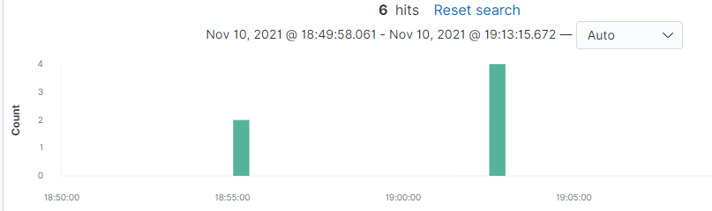
Analysis: Finding the Request for the Hidden Directory
Answer the following questions in bullet points under the screenshot if space allows. Otherwise, add the answers to speaker notes.
What time did the request occur? How many requests were made?
Which files were requested? What did they contain?
destination.ip : 192.168.1.105 and source.ip : 192.168.1.90 and url.path:*secret_folder* and http.response.status_code:200
Two clusters of requests at 18:55 and 19:02.
/company_folders/secret_folder/ 4 /company_folders/secret_folder/connect_to_corp_server 2 connect_to_corp_server → Instructions on connecting to webdav share.
Notes:
Personal Note
In order to connect to our companies webdav server I need to use ryan's account (Hash:d7dad0a5cd7c8376eeb50d69b3ccd352)
I need to open the folder on the left hand bar
2. I need to click "Other Locations“
3. I need to type "dav://172.16.84.205/webdav/“
4. I will be prompted for my user (but i'll use ryans account) and password
5. I can click and drag files into the share and reload my browser

Slide 19
Analysis: Uncovering the Brute Force Attack
Answer the following questions in bullet points under the screenshot if space allows. Otherwise, add the answers to speaker notes.
How many requests were made in the attack?
How many requests had been made before the attacker discovered the password?
destination.ip: 192.168.1.105 and source.ip: 192.168.1.90 and user_agent.original:"Mozilla/4.0 (Hydra)“ and http.response.status_code:401

Slide 20
Analysis: Finding the WebDAV Connection
Answer the following questions in bullet points under the screenshot if space allows. Otherwise, add the answers to speaker notes.
How many requests were made to this directory?
Which files were requested?
/webdav 91
/webdav/passwd.dav 34
/webdav/shell.php 13
/webdav/ 4
/webdav_ 1
destination.ip: 192.168.1.105 and source.ip: 192.168.1.90 and url.path:*webdav*

Slide 21
Analysis: Uploading the reverse shell
destination.ip : 192.168.1.105 and source.ip : 192.168.1.90 and http.request.method : "put"

Slide 22
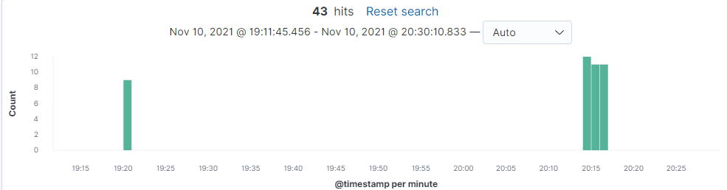
Analysis: Reverse shell connection
destination.port:31337

Slide 23
Analysis: SSH connections
Two password based SSH logins that were us during the engagement.

Slide 24
Blue Team
Proposed Alarms and Mitigation Strategies
24

Slide 25
Mitigation: Blocking the Port Scan
What kind of alarm can be set to detect future port scans?
Knowing the lay of the land: Is someone touching ports that have no service listening? Checking lots of them? Initiating conversations but not having them (either a SYN scan or connect scan with no further data flow)?
What threshold would you set to activate this alarm? As regular scans are noisy, I’d consider maybe 10 ports / hour for stealthier scan attempts. Otherwise, we may have to keep too much state around.
What configurations can be set on the host to mitigate port scans?
Implement host-based firewall or ACLs with tcpwrapper’s host.allow & host.deny.
Block repeat offenders with fail2ban.

Slide 26
Mitigation: Finding the Request for the Hidden Directory
What kind of alarm can be set to detect future unauthorized access?
Assuming this is an internal (i.e. not public) server, monitor the client IP address of the requestor for the secret_folder directory. Alert if it’s not from somewhere with a need to know.
What threshold would you set to activate this alarm? Fairly low … no more than 4 / hour for a single IP address. Raise the alarm sooner if we’re seeing multiple different IP addresses. This will need some tuning to limit fals positives.
What configuration can be set on the host to block unwanted access?
Use Apache module mod_authz_host with directive Require ip / host – restrict to those with valid need to know
Consider mod_rewrite to implement time of day / day of week access restrictions.
Describe the solution. If possible, provide required command lines.
Borrowed from Access Control: https://httpd.apache.org/docs/2.4/howto/access.html

Slide 27
Mitigation: Preventing Brute Force Attacks
What kind of alarm can be set to detect future brute force attacks?
Monitor the number of authorization failures (401) for a given client IP. Send an alert at some clipping level. Optionally, block further requests from the client.
What threshold would you set to activate this alarm?
Using Hydra was obscenely noisy. The 16k requests were done in about 2.5 minutes (average of about 100 a second). In case it’s a fluke, I’d set a threshold around 100 failures/sec for about 5 – 10 seconds.
What configuration can be set on the host to block brute force attacks?
Captchas or other anti-bot mechanisms.
Waste their time. A foyer of sorts that accepts (HTTP 200 OK) any password and forwards to a random Wikipedia page.
Add some time to all password checks (e.g. bcrpyt or PBKDF2).

Slide 28
Mitigation: Detecting the WebDAV Connection
What kind of alarm can be set to detect future access to this directory?
Monitor the client IP address of the requestor to the WebDAV share along with the number of connections. Consider connection times in conjuction with the amount of data transferred for spotting potential data exfiltration.
What threshold would you set to activate this alarm? Maybe more than 5 failed connections per IP to account for password typos. Any connection for a known user from an unknown IP address.
What configuration can be set on the host to control access?
Much like with the hidden directory, use Apache module mod_authz_host with directive Require ip / host – restrict to those with valid need to know
Consider mod_rewrite to implement time of day / day of week access restrictions.
Borrowed from Access Control: https://httpd.apache.org/docs/2.4/howto/access.html

Slide 29
Mitigation: Identifying Reverse Shell Uploads
What kind of alarm can be set to detect future file uploads?
Monitor HTTP put/post/delete requests anywhere they’re allowed (user, IP address and path/object touched).
What threshold would you set to activate this alarm?
A large volume of requests (especially delete). Touching any special paths. Requests from unusual IP addresses or users.
What configuration can be set on the host to block file uploads?
In addition to restricting based on IP or hostname, implement a <Limit> Directive on PUT, POST, or DELETE requests.
Shadow DELETEs and have the file moved to another directory (maybe outside of the web root).
Describe the solution. If possible, provide the required command line.
<Limit POST PUT DELETE>
Require admin-type-users
</Limit>
https://httpd.apache.org/docs/2.4/mod/core.html#limit

Slide 30
Mitigation: WebDAV reverse shell execution
More of a compensating control if a shell is uploaded. Force scriptables in the WebDAV share (e.g. .php or .js), that the webserver could execute, to render as plain text. Examples include: <Location "/php-source">
Dav On
ForceType text/plain
</Location> Apache Module mod_dav: Complex Configurations https://httpd.apache.org/docs/2.4/mod/mod_dav.html
Inside a SetHandler directive https://httpd.apache.org/docs/2.4/mod/core.html#sethandler <FilesMatch "\.php$">
SetHandler default-handler
</FilesMatch>

Slide 31
Backup Slides

Slide 32
Additional Details: Nmap scan results
root@Kali:~# nmap -sn 192.168.1.0/24
Starting Nmap 7.80 ( https://nmap.org ) at 2021-11-19 15:22 PST
Nmap scan report for 192.168.1.1
Host is up (0.00056s latency).
MAC Address: 00:15:5D:00:04:0D (Microsoft)
Nmap scan report for 192.168.1.100
Host is up (0.00081s latency).
MAC Address: 4C:EB:42:D2:D5:D7 (Intel Corporate)
Nmap scan report for 192.168.1.105
Host is up (0.00086s latency).
MAC Address: 00:15:5D:00:04:0F (Microsoft)
Nmap scan report for 192.168.1.90
Host is up.
Nmap done: 256 IP addresses (4 hosts up) scanned in 1.85 seconds

Slide 33
Directory busting …

Slide 34
Hail Hydra?
hydra -l ashton -P /usr/share/wordlists/rockyou.txt -s 80 -vV 192.168.1.105 http-get /company_folders/secret_folder/

Slide 35
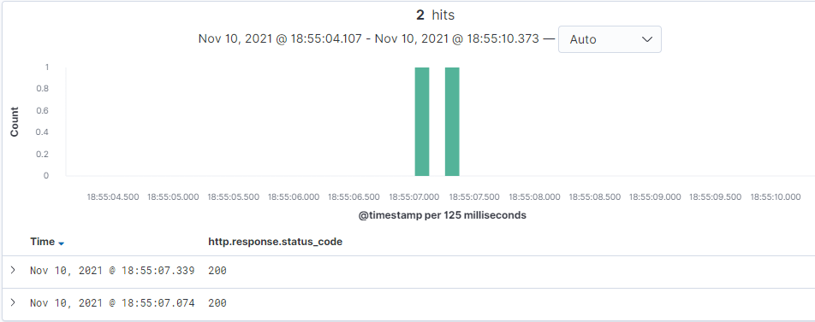
Brute Force Success
destination.ip: 192.168.1.105 and source.ip: 192.168.1.90 and user_agent.original:"Mozilla/4.0 (Hydra)“ and http.response.status_code:200

